Slide 1
St. Louis Central Corridor West Building Permits
Monthly Report: September 2021

Slide 2
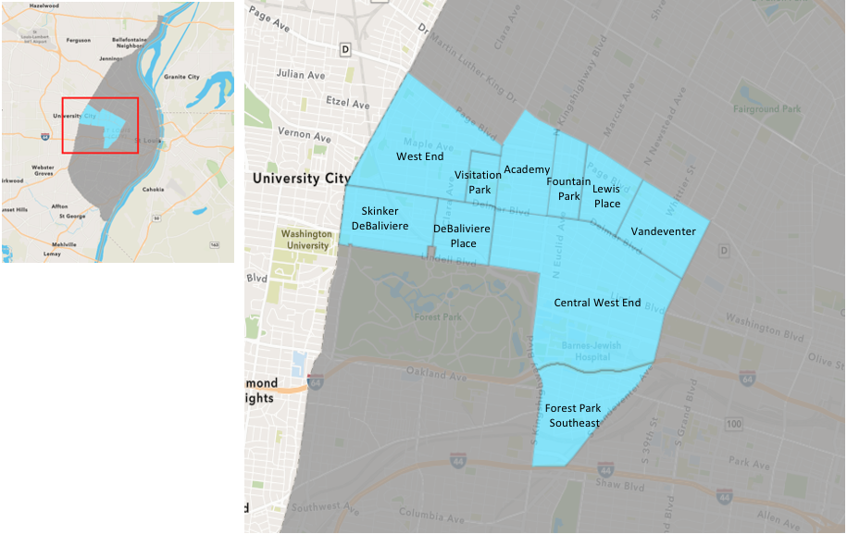
St. Louis Neighborhood Spatial Reference

Slide 3
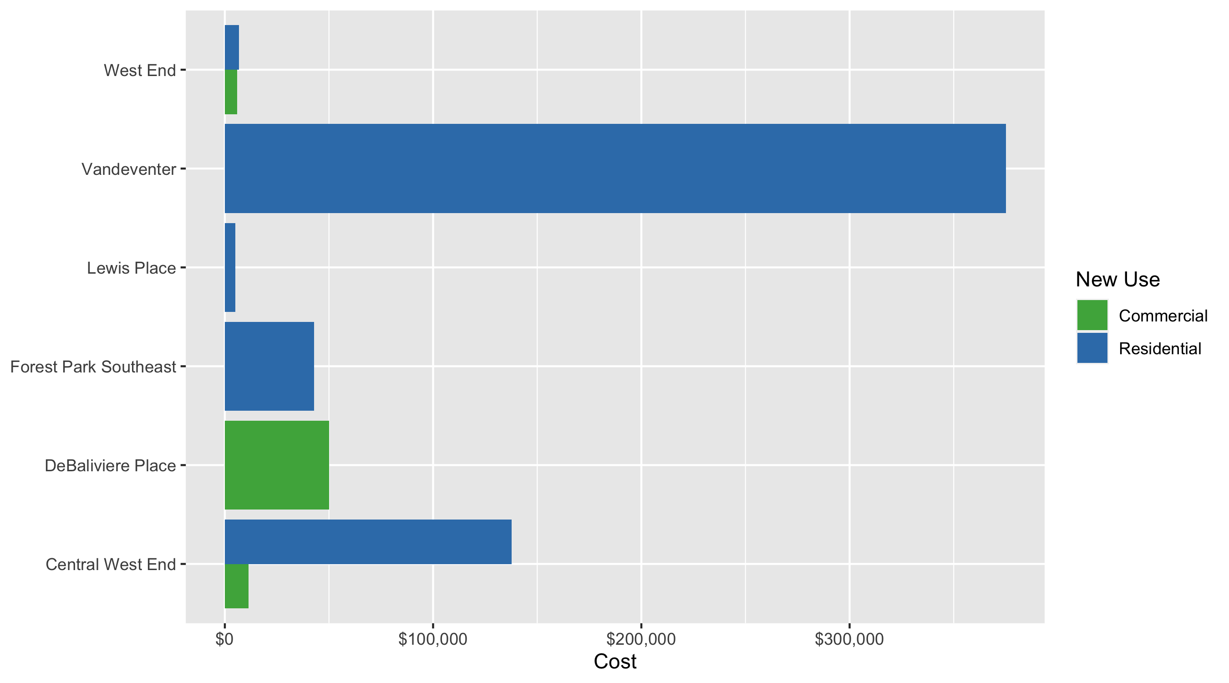
Neighborhood Summary: Average Building Permit Cost

Slide 4
Neighborhood Summary
September 2021 | September 2021 | September 2021 | September 2021
Neighborhood | Average Cost | # of Permits | Total Value of Permits
Academy | $0.000 | 0 | $0
Central West End | $95,633.333 | 6 | $573,800
DeBaliviere Place | $50,000.000 | 1 | $50,000
Forest Park Southeast | $42,750.000 | 2 | $85,500
Fountain Park | $0.000 | 0 | $0
Lewis Place | $5,000.000 | 1 | $5,000
Skinker DeBaliviere | $0.000 | 0 | $0
Vandeventer | $375,000.000 | 2 | $750,000
Visitation Park | $0.000 | 0 | $0
West End | $6,088.429 | 7 | $42,619
Last 6 Months | Last 6 Months | Last 6 Months | Last 6 Months
Neighborhood | Average Cost | # of Permits | Total Value of Permits
Academy | $40,193.09 | 47 | $1,889,075
Central West End | $798,665.44 | 600 | $479,199,264
DeBaliviere Place | $196,175.60 | 81 | $15,890,223
Forest Park Southeast | $398,536.71 | 219 | $87,279,539
Fountain Park | $337,772.70 | 20 | $6,755,454
Lewis Place | $61,463.04 | 27 | $1,659,502
Skinker DeBaliviere | $447,980.87 | 151 | $67,645,111
Vandeventer | $78,504.92 | 24 | $1,884,118
Visitation Park | $17,204.83 | 6 | $103,229
West End | $203,467.63 | 163 | $33,165,223

Slide 5
Core Neighborhoods

Slide 6
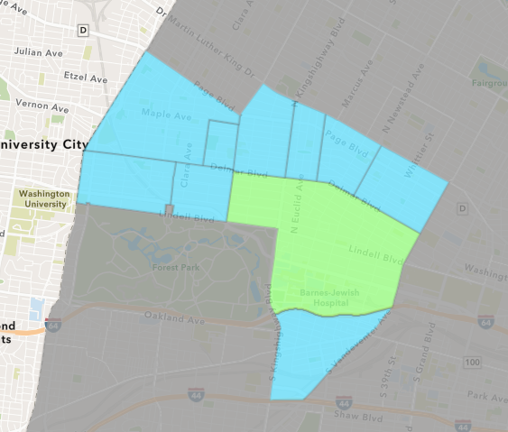
Central West End
September 2021 Neighborhood Cost Breakdown
Mean: $95,633
Median: $12,500
Range: $1,000 - $525,000

Slide 7
Central West End: Summary Notes
6 building permits in September 2021
-85.00% change compared to September 2020 (40 total building permits)
$95,633: Average building permit cost in September 2021
21.47% change compared to September 2020 ($78,730)
288 total building permits in 2021
-2.04% change YTD compared to this time in 2020 (294 total building permits)
$1,259,043: YTD average building permit cost in 2021
307.99% change YTD compared to this time in 2020 ($308,595)

Slide 8
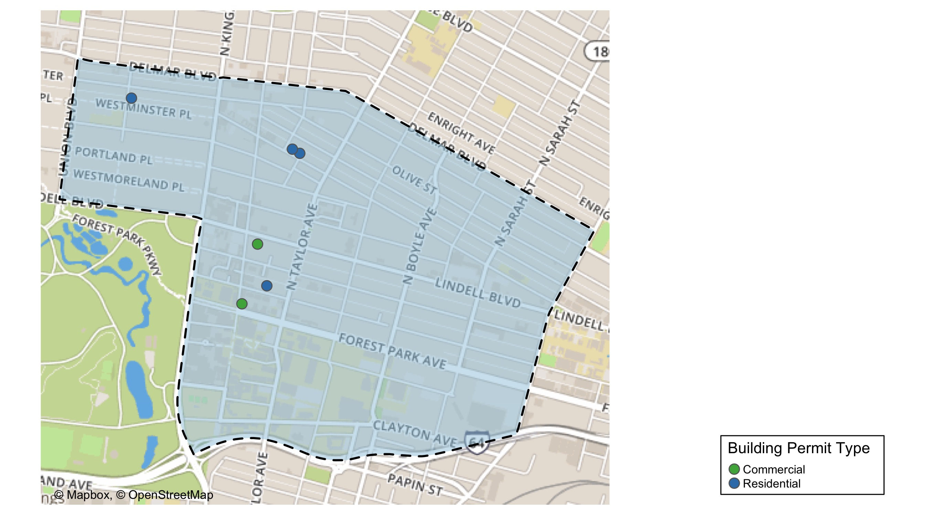
Central West End

Slide 9
Neighborhood Summary
September 2021 | September 2021 | September 2021 | September 2021
Permit Use | Average Cost | # of Permits | Total Value of Permits
Commercial | $11,400 | 2 | $22,800
Industrial | $0 | 0 | $0
Residential | $137,750 | 4 | $551,000
Last 6 Months | Last 6 Months | Last 6 Months | Last 6 Months
Permit Use | Average Cost | # of Permits | Total Value of Permits
Commercial | $1,490,092.0 | 259 | $385,933,831
Industrial | $1,290,150.3 | 26 | $33,543,907
Residential | $189,592.1 | 315 | $59,721,526

Slide 10
Central West End Individual Permit Breakdown
nbhd_name | Owner | New Use | Cost | address
Central West End | MANZANO, ANA RUIZ & ERIC A GALBURT | Residential | $17,000 | 4619 MCPHERSON AV
Central West End | HOLISTIC MISSOURI ST LOUIS LLC | Commercial | $4,000 | 20 S EUCLID AV
Central West End | BROWN, ROBERT P & KIM M | Residential | $1,000 | 4601 MCPHERSON AV
Central West End | WILLERS, WILLIAM JR & | Residential | $8,000 | 512 LAKE AV
Central West End | 4545 LACLEDE VENTURES LLC | Residential | $525,000 | 4545 LACLEDE AV
Central West End | CENTRAL WEST END HOTEL GROUP LLC | Commercial | $18,800 | 4630 LINDELL BLVD

Slide 11
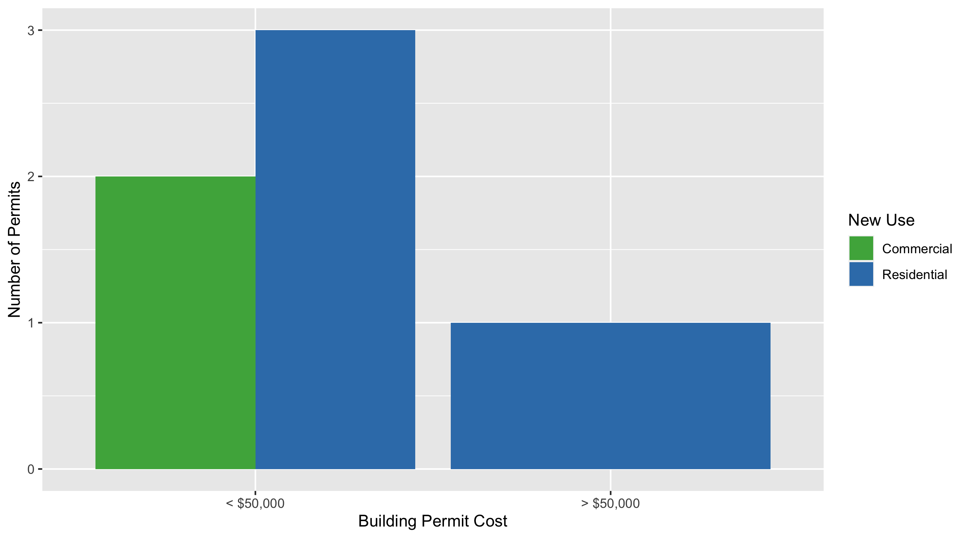
Central West End Permit Cost Breakdown

Slide 12
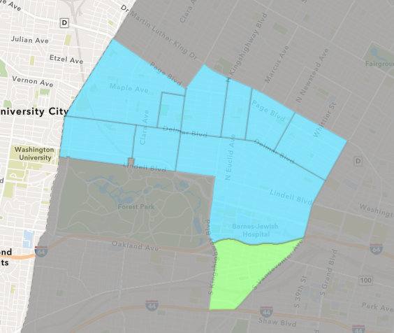
Forest Park Southeast
September 2021 Neighborhood Cost Breakdown
Mean: $42,750
Median: $42,750
Range: $500 - $85,000

Slide 13
Forest Park Southeast: Summary Notes
2 building permits in September 2021
-81.82% change compared to September 2020 (11 total building permits)
$42,750: Average building permit cost in September 2021
11.94% change compared to September 2020 ($38,191)
124 total building permits in 2021
47.62% change YTD compared to this time in 2020 (84 total building permits)
$498,828: YTD average building permit cost in 2021
161.81% change YTD compared to this time in 2020 ($190,531)

Slide 14
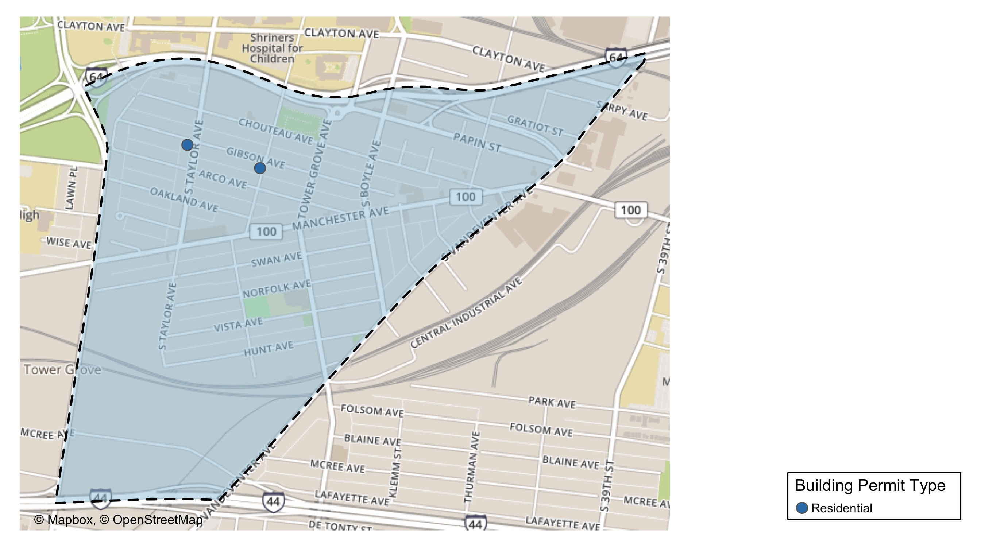
Forest Park Southeast

Slide 15
Neighborhood Summary
September 2021 | September 2021 | September 2021 | September 2021
Permit Use | Average Cost | # of Permits | Total Value of Permits
Commercial | $0 | 0 | $0
Industrial | $0 | 0 | $0
Residential | $42,750 | 2 | $85,500
Last 6 Months | Last 6 Months | Last 6 Months | Last 6 Months
Permit Use | Average Cost | # of Permits | Total Value of Permits
Commercial | $443,237.56 | 59 | $26,151,016
Industrial | $69,745.38 | 13 | $906,690
Residential | $409,672.33 | 147 | $60,221,833

Slide 16
Forest Park Southeast Individual Permit Breakdown
nbhd_name | Owner | New Use | Cost | address
Forest Park Southeast | PARK EAST II LP | Residential | $85,000 | 4400 GIBSON AV
Forest Park Southeast | PARK EAST II LP | Residential | $500 | 1035-37 S TAYLOR AV

Slide 17
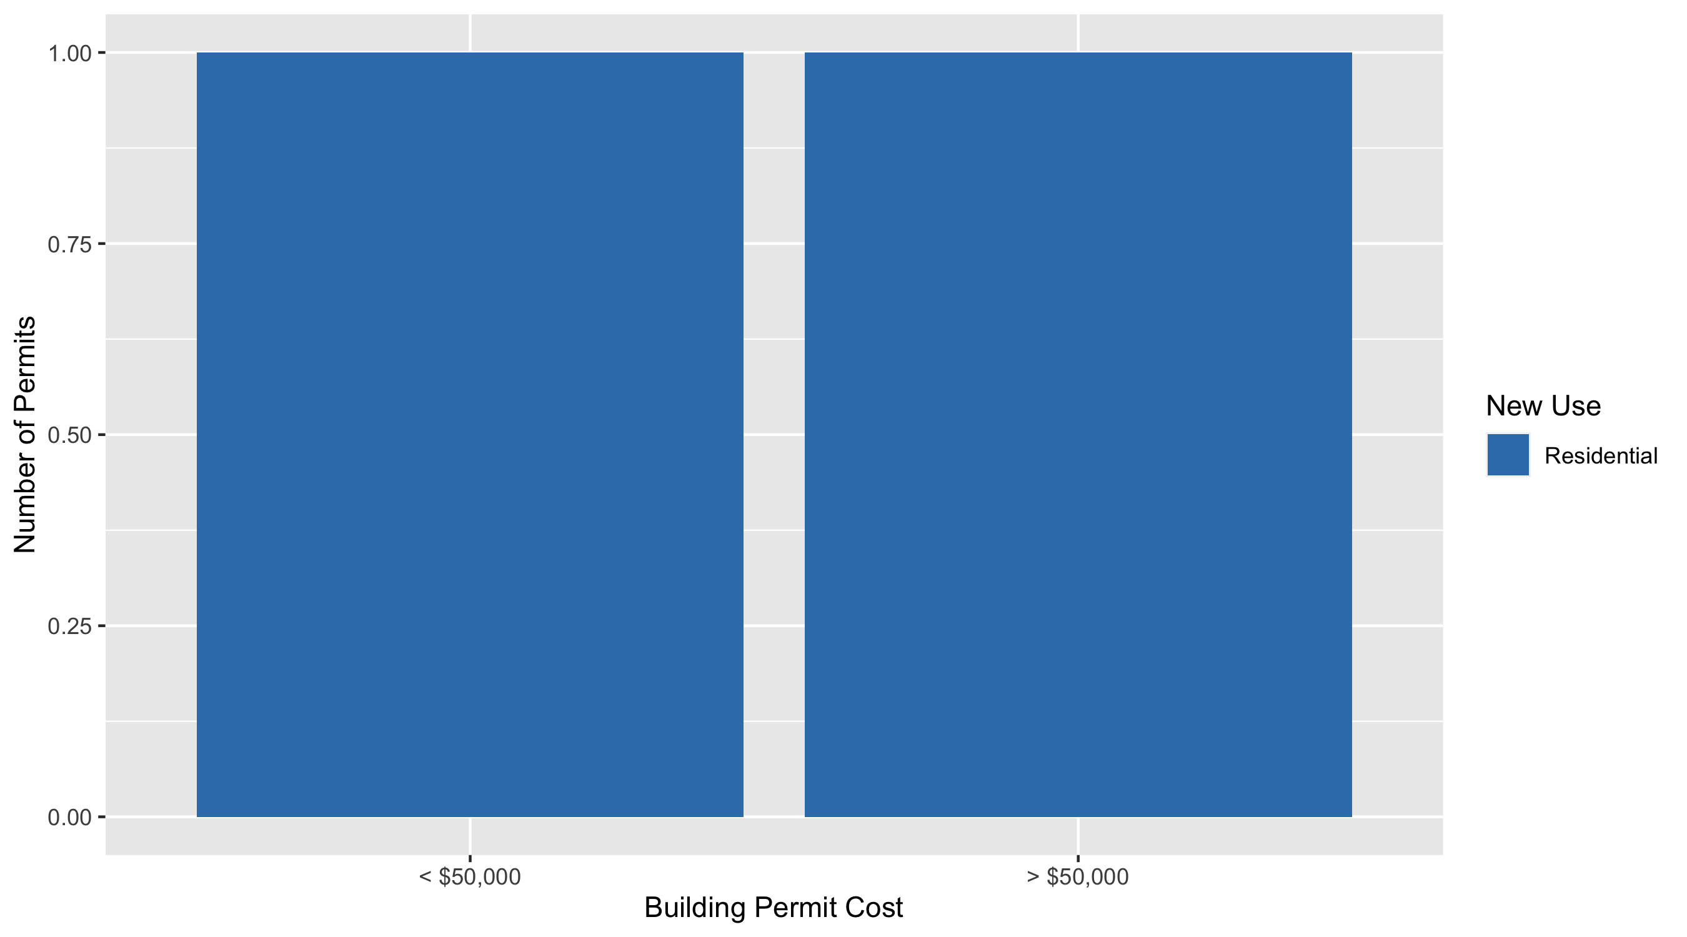
Forest Park Southeast Permit Cost Breakdown

Slide 18
Expanded Service Area

Slide 19
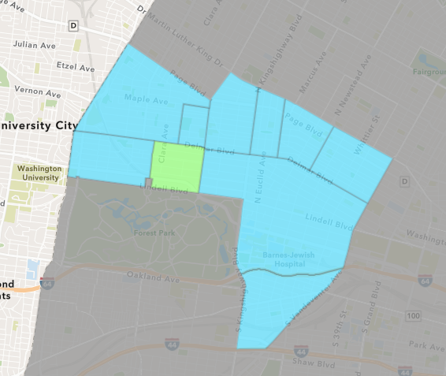
DeBaliviere Place
September 2021 Neighborhood Cost Breakdown
Mean: $50,000
Median: $50,000
Range: $50,000 - $50,000

Slide 20
DeBaliviere Place: Summary Notes
1 building permits in September 2021
-75.00% change compared to September 2020 (4 total building permits)
$50,000: Average building permit cost in September 2021
304.15% change compared to September 2020 ($12,372)
39 total building permits in 2021
44.44% change YTD compared to this time in 2020 (27 total building permits)
$88,502: YTD average building permit cost in 2021
-37.99% change YTD compared to this time in 2020 ($142,727)

Slide 21
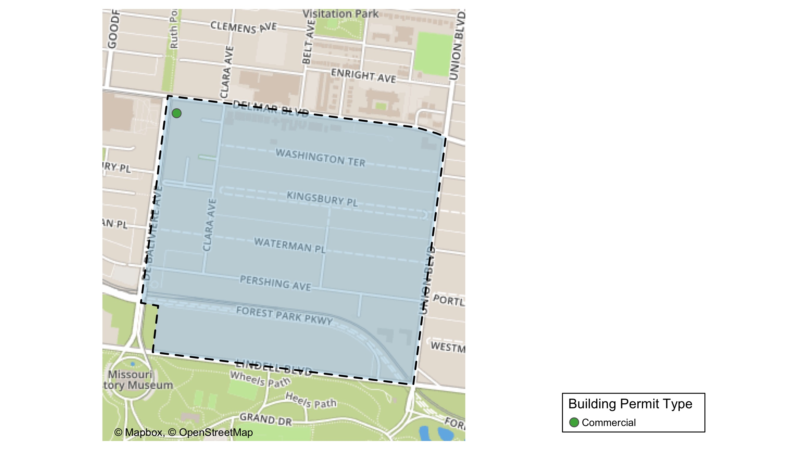
DeBaliviere Place

Slide 22
Neighborhood Summary
September 2021 | September 2021 | September 2021 | September 2021
Permit Use | Average Cost | # of Permits | Total Value of Permits
Commercial | $50,000 | 1 | $50,000
Industrial | $0 | 0 | $0
Residential | $0 | 0 | $0
Last 6 Months | Last 6 Months | Last 6 Months | Last 6 Months
Permit Use | Average Cost | # of Permits | Total Value of Permits
Commercial | $35,828.0 | 7 | $250,796
Industrial | $34,500.0 | 3 | $103,500
Residential | $218,815.9 | 71 | $15,535,927

Slide 23
DeBaliviere Place Individual Permit Breakdown
nbhd_name | Owner | New Use | Cost | address
DeBaliviere Place | 5654 DELMAR LLC P | Commercial | $50,000 | 566 DEBALIVIERE AV

Slide 24
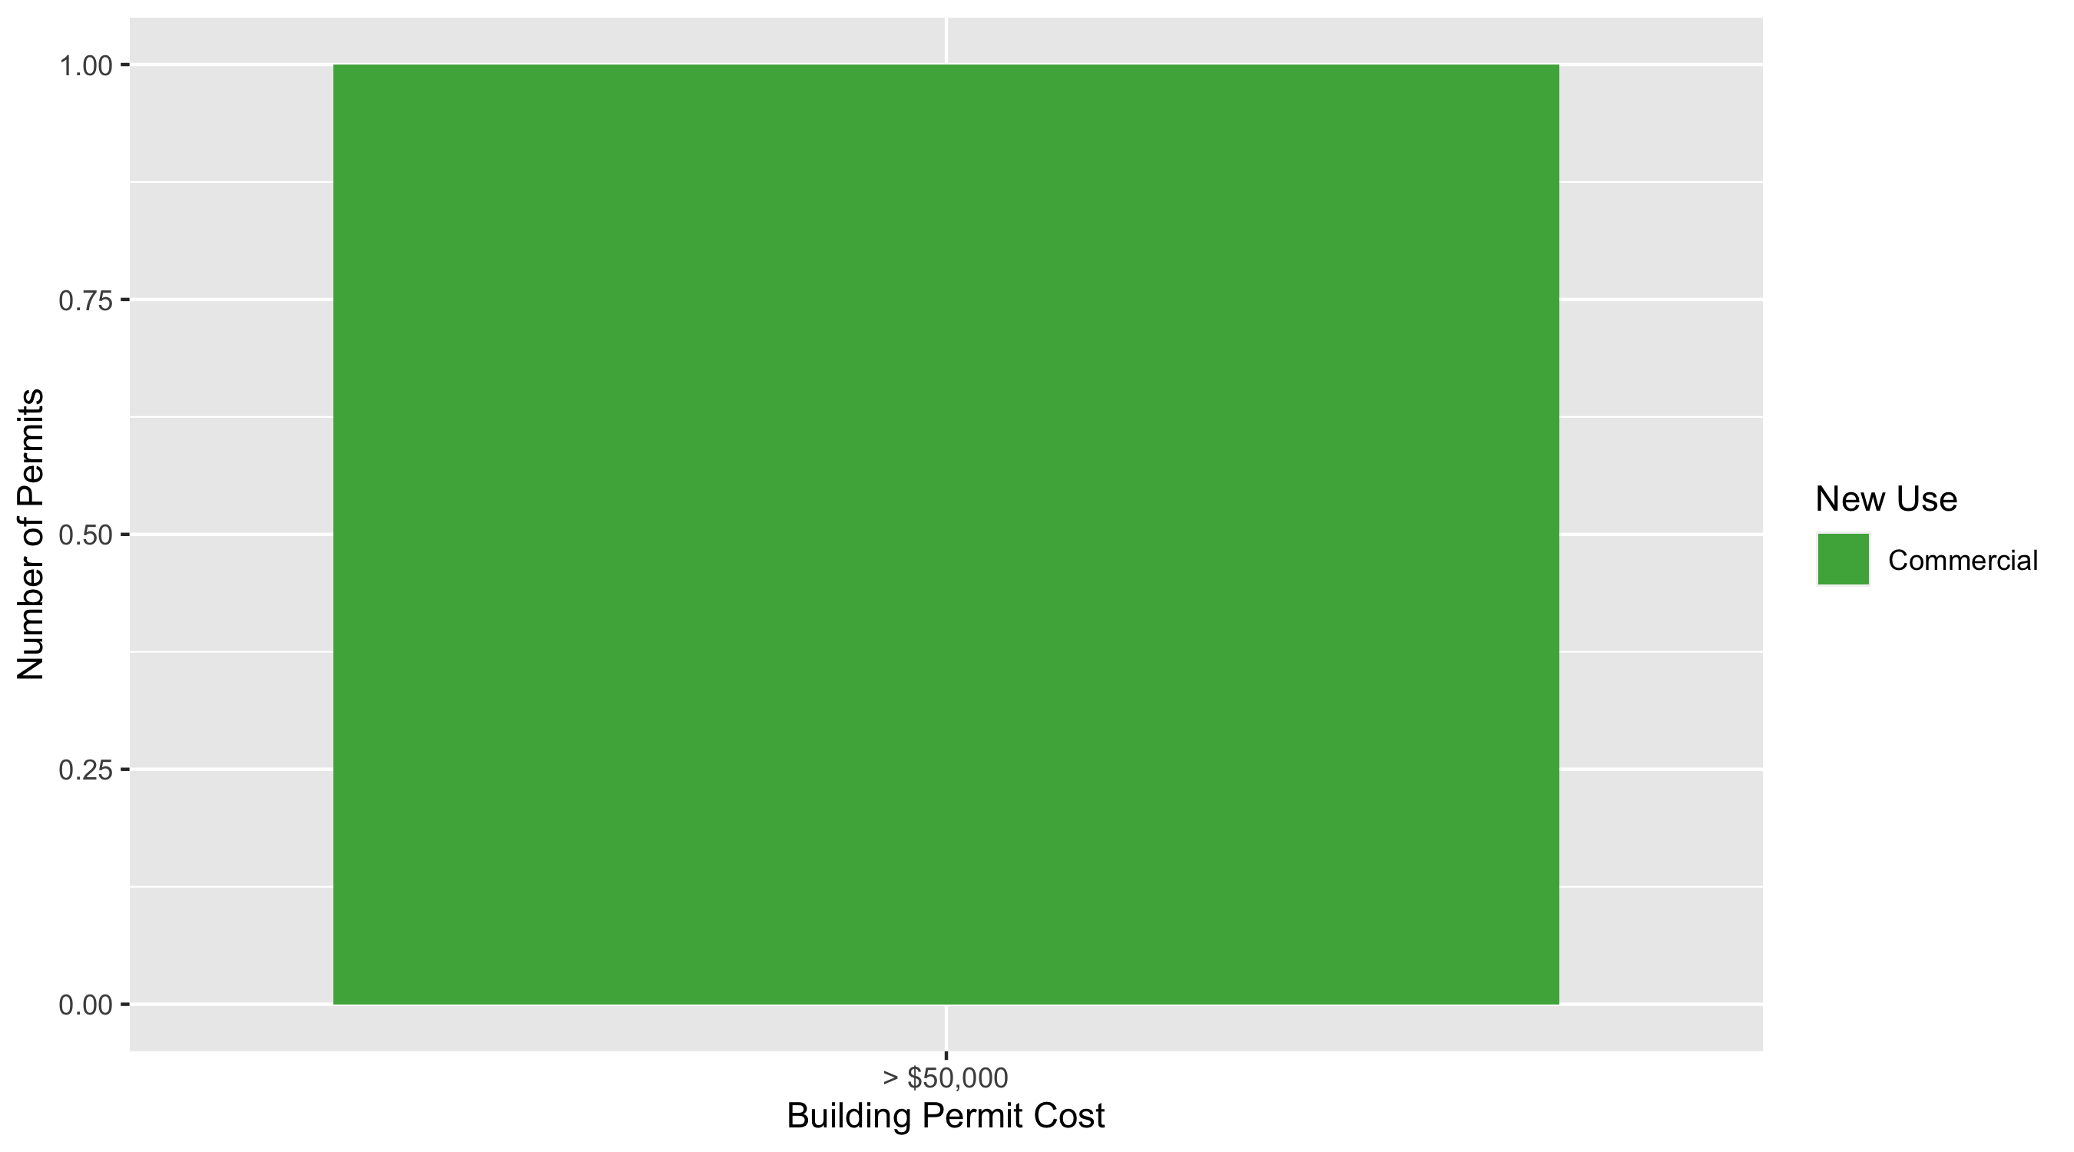
DeBaliviere Place Permit Cost Breakdown

Slide 25
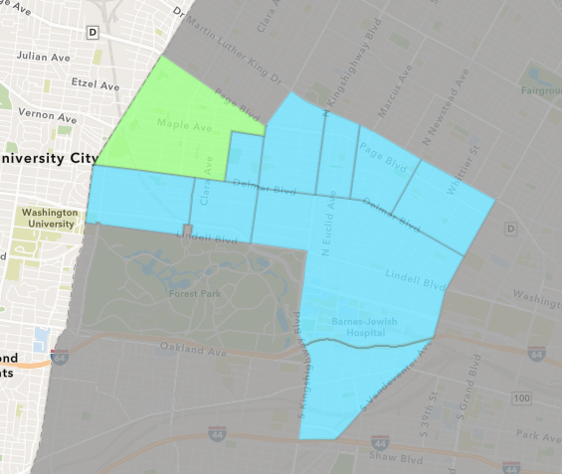
West End
September 2021 Neighborhood Cost Breakdown
Mean: $6,088
Median: $4,825
Range: $2,500 - $11,000

Slide 26
West End: Summary Notes
7 building permits in September 2021
-36.36% change compared to September 2020 (11 total building permits)
$6,088: Average building permit cost in September 2021
-47.47% change compared to September 2020 ($11,591)
105 total building permits in 2021
69.35% change YTD compared to this time in 2020 (62 total building permits)
$83,815: YTD average building permit cost in 2021
-71.22% change YTD compared to this time in 2020 ($291,236)

Slide 27
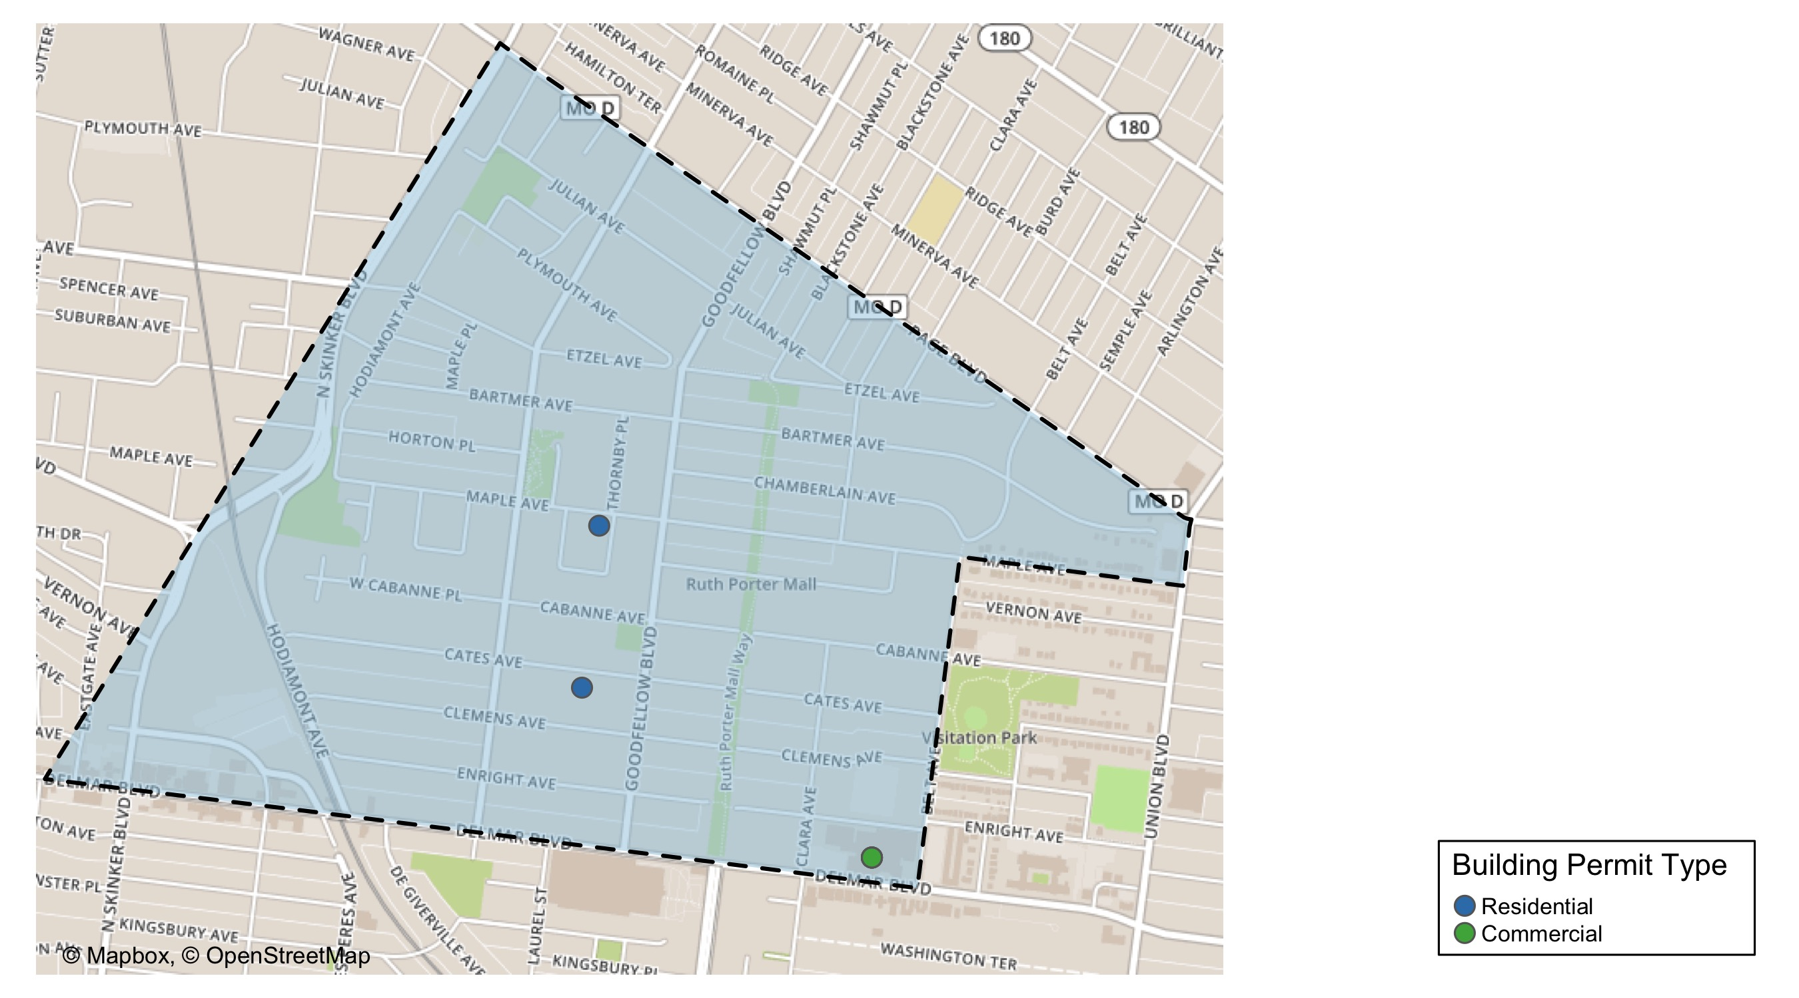
West End

Slide 28
Neighborhood Summary
September 2021 | September 2021 | September 2021 | September 2021
Permit Use | Average Cost | # of Permits | Total Value of Permits
Commercial | $5,823.8 | 5 | $29,119
Industrial | $0.0 | 0 | $0
Residential | $6,750.0 | 2 | $13,500
Last 6 Months | Last 6 Months | Last 6 Months | Last 6 Months
Permit Use | Average Cost | # of Permits | Total Value of Permits
Commercial | $301,579.38 | 48 | $14,475,810
Industrial | $15,463.46 | 13 | $201,025
Residential | $181,258.71 | 102 | $18,488,388

Slide 29
West End Individual Permit Breakdown
nbhd_name | Owner | New Use | Cost | address
West End | DELMAR DIVINE MASTER LANDLORD | Commercial | $10,295 | 5535 DELMAR BLVD
West End | DELMAR DIVINE CONDO | Commercial | $3,888 | 5535 DELMAR BLVD
West End | DELMAR DIVINE CONDO | Commercial | $3,804 | 5535 DELMAR BLVD
West End | DELMAR DIVINE CONDO | Commercial | $4,825 | 5535 DELMAR BLVD
West End | DELMAR DIVINE CONDO | Commercial | $6,307 | 5535 DELMAR BLVD
West End | LEE, MICHAEL V | Residential | $11,000 | 5840 CATES AV
West End | WILSON, TATIA K | Residential | $2,500 | 5844 MAPLE AV

Slide 30
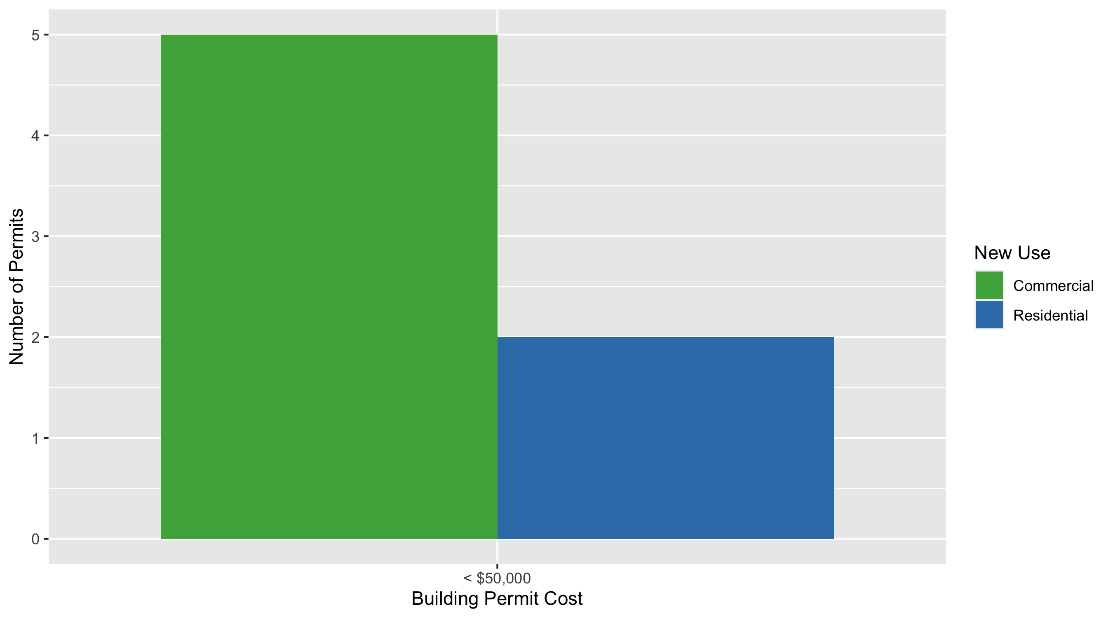
West End Permit Cost Breakdown

Slide 31
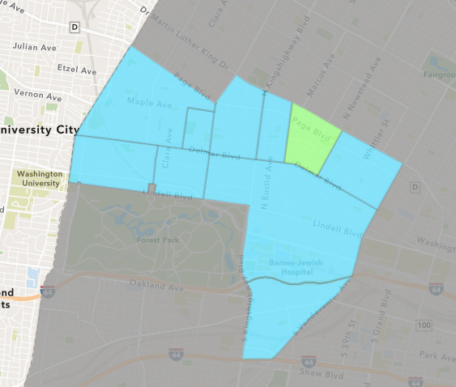
Lewis Place
September 2021 Neighborhood Cost Breakdown
Mean: $5,000
Median: $5,000
Range: $5,000 - $5,000

Slide 32
Lewis Place: Summary Notes
1 building permits in September 2021
-66.67% change compared to September 2020 (3 total building permits)
$5,000: Average building permit cost in September 2021
-91.17% change compared to September 2020 ($56,597)
14 total building permits in 2021
100.00% change YTD compared to this time in 2020 (7 total building permits)
$91,386: YTD average building permit cost in 2021
262.52% change YTD compared to this time in 2020 ($25,209)

Slide 33
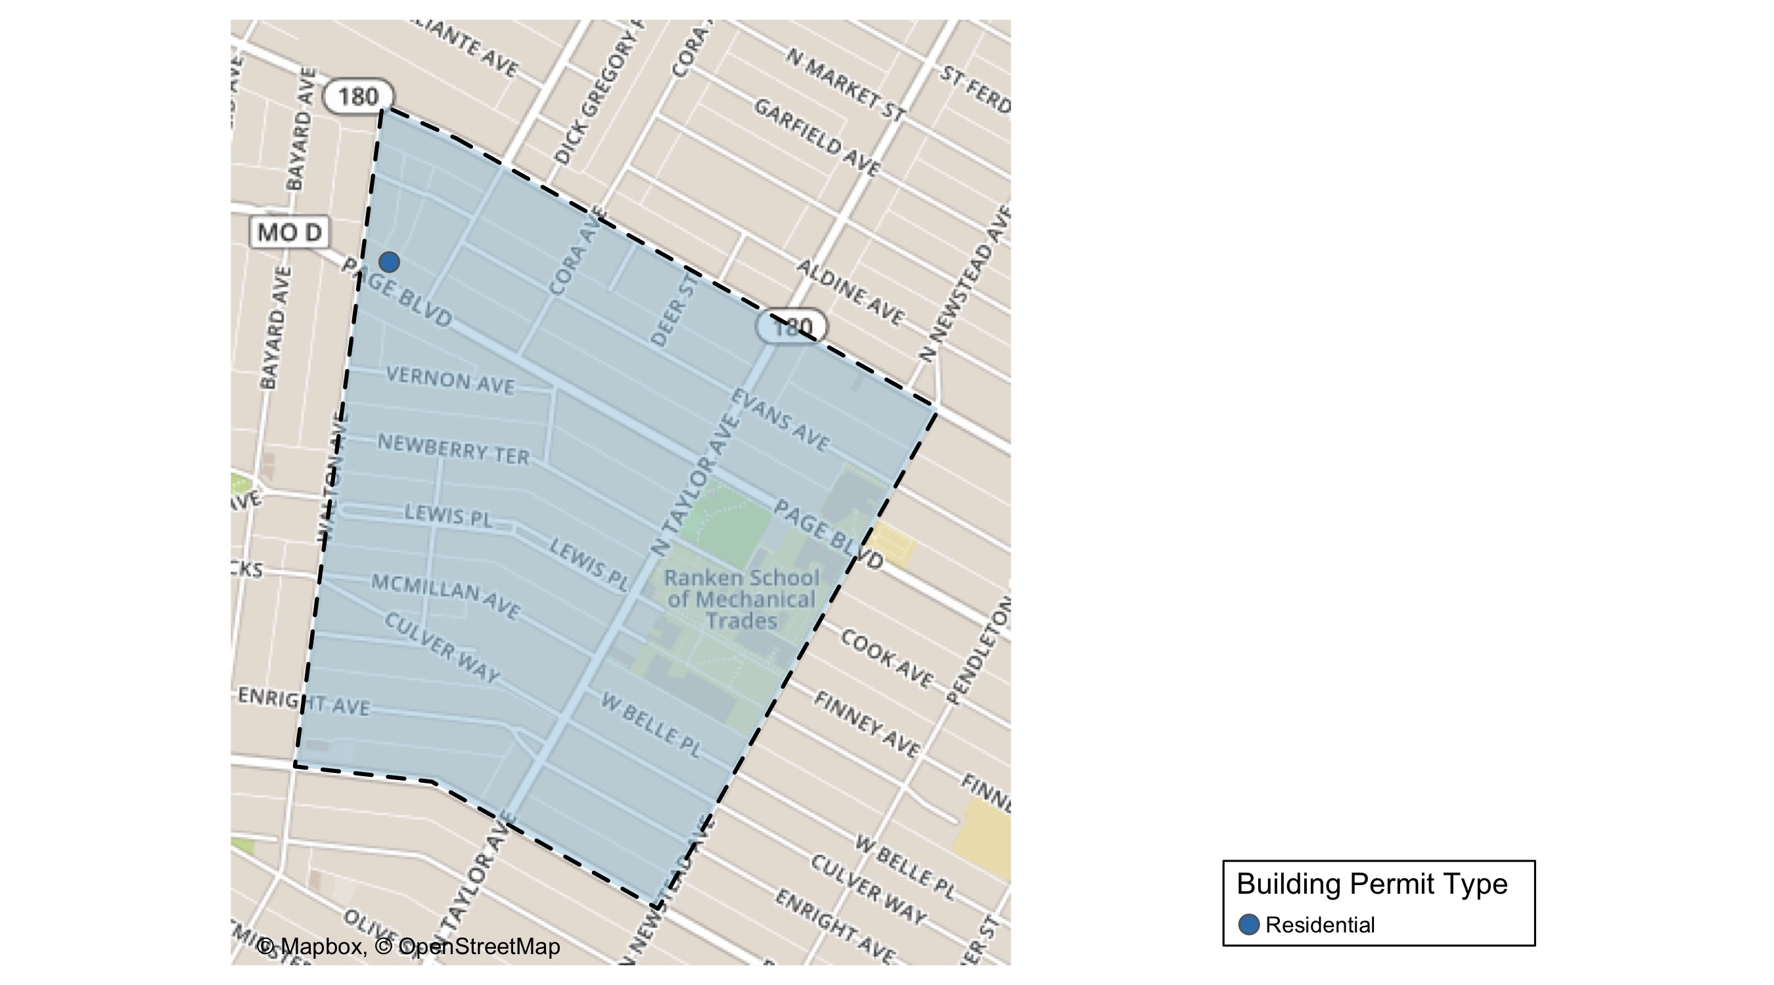
Lewis Place

Slide 34
Neighborhood Summary
September 2021 | September 2021 | September 2021 | September 2021
Permit Use | Average Cost | # of Permits | Total Value of Permits
Commercial | $0 | 0 | $0
Industrial | $0 | 0 | $0
Residential | $5,000 | 1 | $5,000
Last 6 Months | Last 6 Months | Last 6 Months | Last 6 Months
Permit Use | Average Cost | # of Permits | Total Value of Permits
Commercial | $225,867.20 | 5 | $1,129,336
Industrial | $18,733.33 | 3 | $56,200
Residential | $24,945.58 | 19 | $473,966

Slide 35
Lewis Place Individual Permit Breakdown
nbhd_name | Owner | New Use | Cost | address
Lewis Place | GRAVES, JOHN E | Residential | $5,000 | 4727 PAGE BLVD

Slide 36
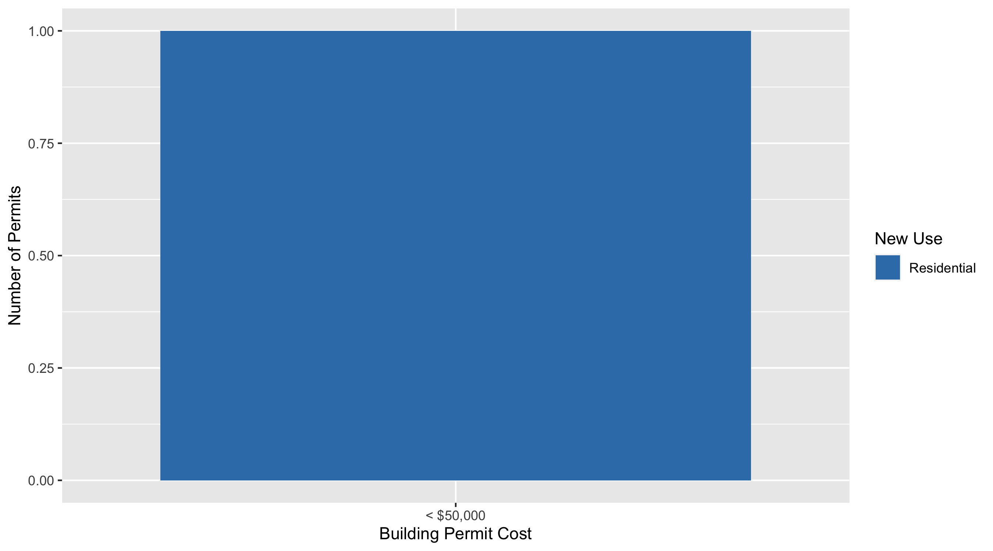
Lewis Place Permit Cost Breakdown

Slide 37
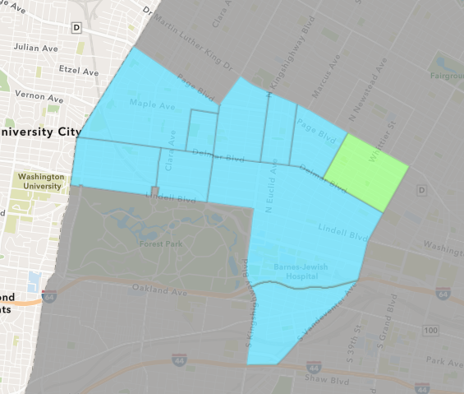
Vandeventer
September 2021 Neighborhood Cost Breakdown
Mean: $375,000
Median: $375,000
Range: $375,000 - $375,000

Slide 38
Vandeventer: Summary Notes
2 building permits in September 2021
100.00% change compared to September 2020 (1 total building permits)
$375,000: Average building permit cost in September 2021
158.62% change compared to September 2020 ($145,000)
10 total building permits in 2021
11.11% change YTD compared to this time in 2020 (9 total building permits)
$124,630: YTD average building permit cost in 2021
110.81% change YTD compared to this time in 2020 ($59,120)

Slide 39
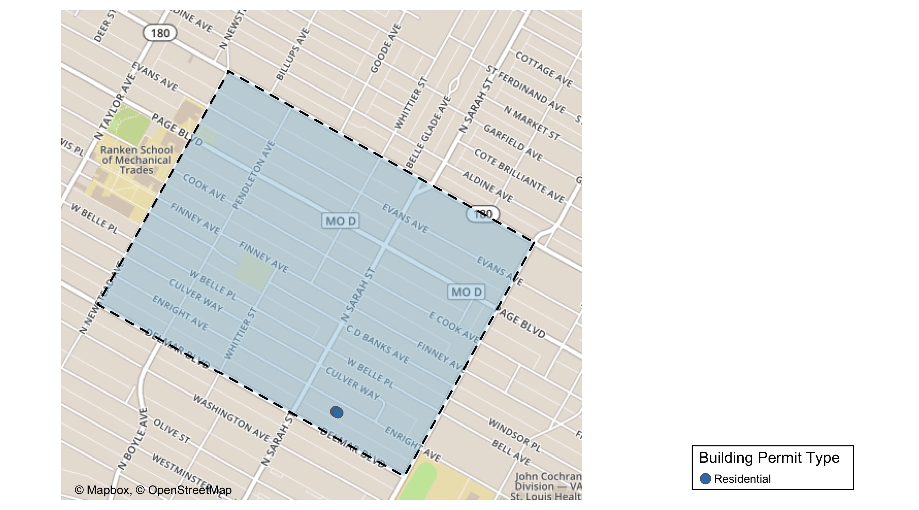
Vandeventer

Slide 40
Neighborhood Summary
September 2021 | September 2021 | September 2021 | September 2021
Permit Use | Average Cost | # of Permits | Total Value of Permits
Commercial | $0 | 0 | $0
Industrial | $0 | 0 | $0
Residential | $375,000 | 2 | $750,000
Last 6 Months | Last 6 Months | Last 6 Months | Last 6 Months
Permit Use | Average Cost | # of Permits | Total Value of Permits
Commercial | $28,223.00 | 3 | $84,669
Industrial | $3,650.00 | 2 | $7,300
Residential | $94,323.63 | 19 | $1,792,149

Slide 41
Vandeventer Individual Permit Breakdown
nbhd_name | Owner | New Use | Cost | address
Vandeventer | MINCY, MARRISSA | Residential | $375,000 | 4024 ENRIGHT AV
Vandeventer | MINCY, MARRISSA | Residential | $375,000 | 4028 ENRIGHT AV

Slide 42
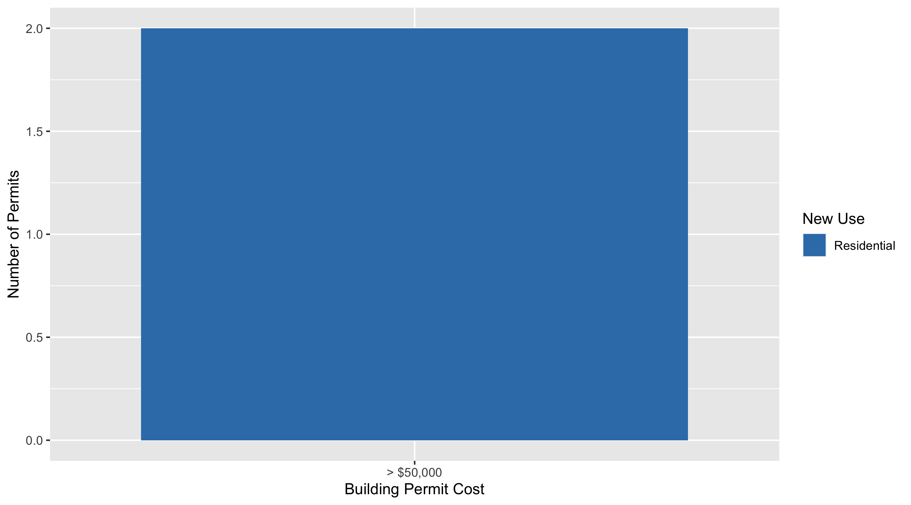
Vandeventer Permit Cost Breakdown

Slide 43
Additional Notes
Data retreived from https://www.stlouis-mo.gov/data/
Building permits with a cost of $0 were dropped
Building permits that were cancelled were dropped
Infinite change indicates 0 permits in the current or previous time period/comparison month so there was a overall increase or decrease

